Slide 1
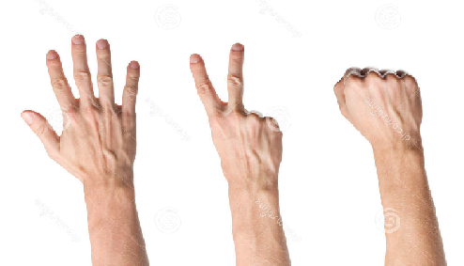
Rock Paper Scissors Image Classification
by Matan-Ben Nagar & Yaara Kresner-Barak

Slide 2
About the project
In this project we have a multinomial classification problem.
We wish to develop a model for identifying whether an image of a hand demonstrates a rock, paper or scissors.

Slide 3
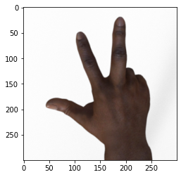
Our data set
Our dataset contains 2892 image
of hands playing rock, paper, scissor game.
The features:
Images pixels
The class labels divided to rock(1), paper(2) and scissors(3).

Slide 4
Divide TO Test & train
The train set contains 2520 images, and the test set contains 372 images.
ds_train = tfds.load(name="rock_paper_scissors", split="train")
ds_test = tfds.load(name="rock_paper_scissors", split="test")

Slide 5
Preprocessing- preparing data
Converting the tensorflow dataset format into numpy format
Change the images three color channels RGB format to one color channel
train_images = np.array([example['image'].numpy()[:,:,0] for example in ds_train])
test_images = np.array([example['image'].numpy()[:,:,0] for example in ds_test])
Notes:
עבודה עם תמונות היא טריקית בגלל המימדים שלהם ולכן נעדיף להמיר את התמונות למערכי פיקסלים, צעד נהוג כשמעבדים ולומדים תמונות
צעד נוסף וחשוב כשמאמנים מודלים על תמונות הוא להסיר מידע שהוא לא רלוונטי. במקרה שלנו הסרנו את צבע התמונה באמצעות הסרת המימד השלישי

Slide 6
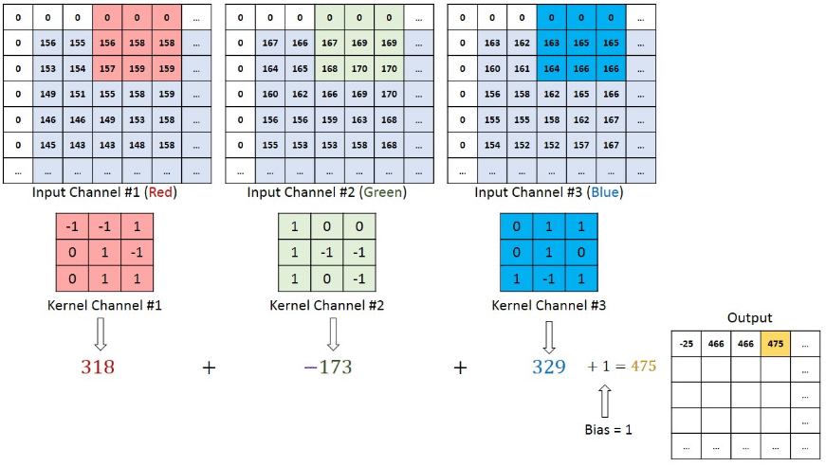
GREYSCALE Images – why?
Images are nothing but numeric values ranging from 0 to 255 stored in neat arrays for our computer to display saturation.
Notes:
בתמונה ניתן לראות כיצד רשת הנוירונים שלנו קוראת את התמונה,
באמצעות שלושה ערוצים שונים RGB ,
מבצעת מיפוי של הפיקסלים.

Slide 7
GREYSCALE Images – why?
Grayscale images, on the other hand, only store values in a single array (black and white), meaning the above calculation only requires a single convolution to be calculated.
It is the shape of the hand that matters for our classification, not the color of it.
Greyscaling the images helps generalizing the model
Notes:
יעילות: במקום 3 convolutions שהרשת שלנו תבצע, היא תצטרך לבצע רק convulotion אחד
חשיבות : המודל שלנו לא צריך להתחשב בצבעים , אלא רק בקווי המתאר
פורמט שחור לבן עוזר לנו להכליל את המידע שלנו , להוריד את כמות הדאטה שהמודל צריך ללמוד

Slide 8
Normalization
Convert the data type from integer to float -getting ready to normalize.
train_images = train_images.astype('float32')
test_images = test_images.astype('float32’)
train_images /= 255
test_images /= 255
Why?
RGB values are between 0 and 255.
A common step is scaling every value to be between 0 & 1 which helps with classification.
Notes:
המרת הנתונים לערכים בין 0 ל-1 מאפשרת ביצועים טובים יותר של המודל.

Slide 9
Building the cnn – First attempt
model = keras.Sequential([
keras.layers.Conv2D(64, 3, activation='relu', input_shape=(300,300,1)),
keras.layers.Conv2D(32, 3, activation='relu'),
keras.layers.Flatten(),
keras.layers.Dense(3, activation='softmax')
])
Notes:
להסביר על CONV2D
RELU
FLATTEN
DENSE
SOFT-MAX
SEQUENTIAL

Slide 10
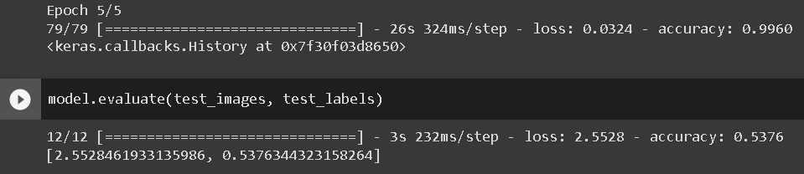
OVERFITTING
Apparently our data was overfitting.
We can see it by the training results vs testing results.
Why?
We don’t have that many training images in our dataset
Our images are 300x300 which is high, and the convolutional recgtangle is 3x3 which is very small.

Slide 11
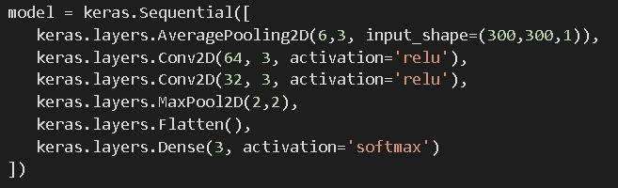
Attempt 2 – reducing the size of the images
AveragePooling2D
The function will iterate the image using a a square and creating new pixels based on the average pixels.
MaxPool2D
Take the max pixel in each 2 by 2 grid that is iterating over the image. Individual pixels don’t have as much weight anymore.
Notes:
הפיתרון- הורדת "האיכות" של התמונה – הורדת החשיבות של כל פיקסל בעזרת חישוב ממוצע של כמות פיקסלים מסויימת וייצוגם רק בעזרת פיקסל יחיד
שכבת ה-דנס תהווה ייצוג ביניים של המידע ובתקווה "תתפוס" את המידע החשוב ותנקז אותו עם השכבה האחרונה ל-3 נוירונים.

Slide 12
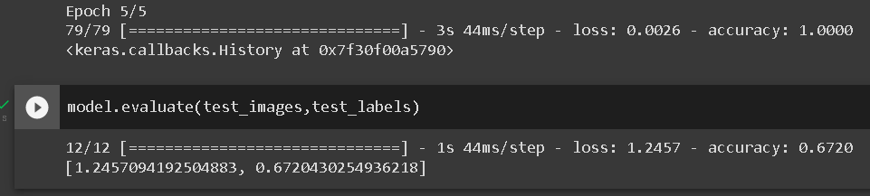
Notes:
התוצאות השתפרו, אבל עדיין לא מספיק.

Slide 13
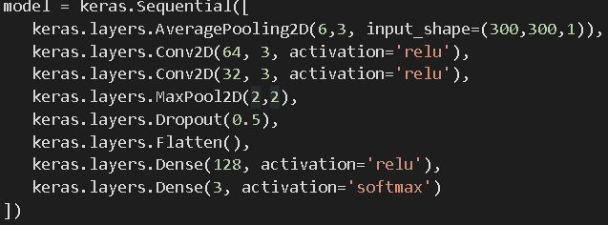
Attempt 3
DropOut
This layer will simulate having more training examples. Dropout will cut out 50% of the connections. Ultimately the epochs will be more effective because the data will be more interesting. the individual connections will have to generalize more and be able to handle more variation.
Notes:
הפונקציה תוך כדי אימון מוותרת על חצי מהקשרים שנוצרו ברשת שלנו .

Slide 14
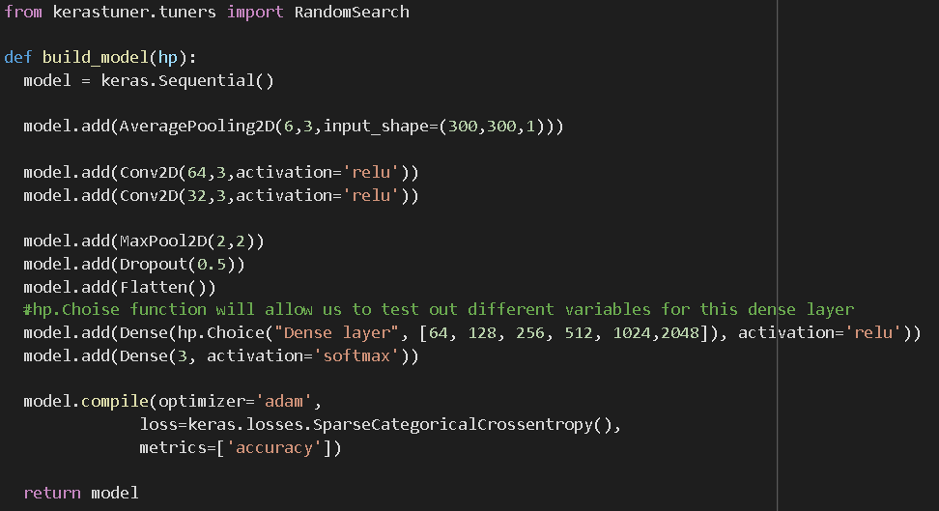
Keras tuner – hyper parameter

Slide 15
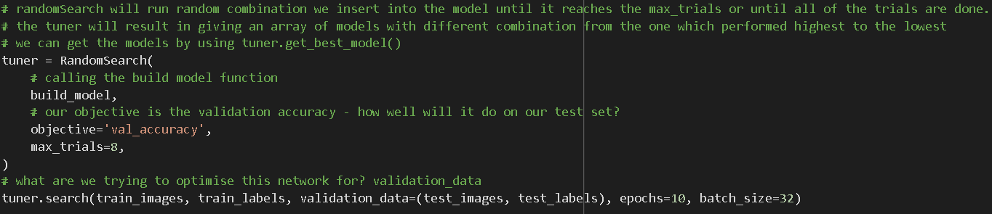
Keras tuner – hyper parameter

Slide 16
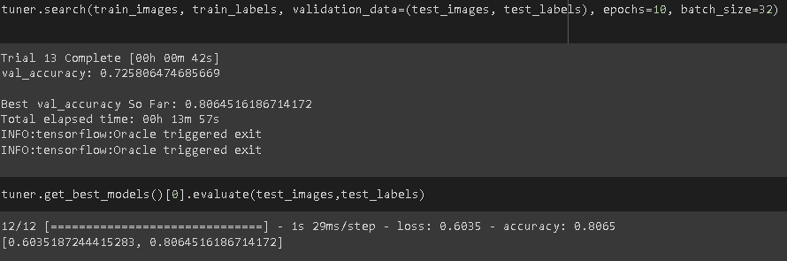
Keras tuner – hyper parameter
KerasTuner is an easy-to-use, scalable hyperparameter optimization framework that solves the pain points of hyperparameter search. Easily configure your search space with a define-by-run syntax, then leverage one of the available search algorithms to find the best hyperparameter values for your models.

Slide 17
Building the logistic regression model
At first, we build a basic model for our problem and check the results:
# Output layer.
model_lr = keras.Sequential([
keras.layers.Flatten(),
keras.layers.Dense(3, activation='softmax')])

Slide 18


the logistic regression model results:
The model got 55% correct on the training set.
Epoch 1/5 79/79 [==============================] - 1s 8ms/step - loss: 55.7900 - accuracy: 0.3520
Epoch 2/5 79/79 [==============================] - 1s 8ms/step - loss: 36.7753 - accuracy: 0.4405
Epoch 3/5 79/79 [==============================] - 1s 8ms/step - loss: 35.0457 - accuracy: 0.4516
Epoch 4/5 79/79 [==============================] - 1s 8ms/step - loss: 29.2264 - accuracy: 0.5083
Epoch 5/5 79/79 [==============================] - 1s 8ms/step - loss: 25.4947 - accuracy: 0.5544
The model got 36% correct on the testing set after training.
12/12 [==============================] - 0s 7ms/step - loss: 41.0644 –
accuracy: 0.3683

Slide 19
Building a basic neural network model:
This model network layer transform the 300 by 300 image into single column, After that we have two layers of activation relu function- because the constant gradient of ReLUs results in faster learning. Finally ,the output layer going to be the same size as the number of labels we trying to classify- we use softmax because it efficient in classification problems.
model = keras.Sequential([
keras.layers.Flatten(),
Dense(512, activation='relu'),
Dense(256, activation='relu'),
Dense(3, activation='softmax')
])
#setup loss function
model.compile(optimizer='adam',
loss=keras.losses.SparseCategoricalCrossentropy(),
metrics=['accuracy'])
#fit our data to the model
model.fit(train_images, train_labels, epochs=5, batch_size=32)

Slide 20


The neural network results:
The model results on the training set:
Epoch 1/5 79/79 [==============================] - 3s 34ms/step - loss: 28.7511 - accuracy: 0.3940
Epoch 2/5 79/79 [==============================] - 3s 33ms/step - loss: 1.1945 - accuracy: 0.6659
Epoch 3/5 79/79 [==============================] - 3s 33ms/step - loss: 0.6275 - accuracy: 0.7802
Epoch 4/5 79/79 [==============================] - 3s 33ms/step - loss: 0.6796 - accuracy: 0.7714
Epoch 5/5 79/79 [==============================] - 3s 33ms/step - loss: 0.7040 - accuracy: 0.7710
12/12 [==============================] - 0s 12ms/step - loss: 1.2561 - accuracy: 0.5753
In this case we overfitting to our data - the model is not learning the train data. we can see it by the results- the accuracy in the train data is 0.77, and the accuracy in the test data is 0.57.
The model results on the testing set after training.

Slide 21
RESULTS
 | Logistic Regression (Soft-max) | MLP | CNN | CNN & KERAS TUNER
Train accuracy | 0.5544 | 0.771 | 1 | 1
Test accuracy | 0.3683 | 0.5753 | 0.672 | 0.804

Slide 22
CONCLUSIONS
In conclusion, convoluted neural networks appear to be efficient and smart in comparison to other machine-learning algorithms. The main advantage of CNN compared to its predecessors is that it automatically detects the important features without any human supervision. Little dependence on preprocessing, decreasing the needs of human effort developing its functionalities. From this experience, we gathered that CNN might overfit quickly and thus require additional effort in generalizing.

